Slide 1
City of Port Lavaca
Five Year Capital Improvement Program
2017-2018 FY to 2021-2022 FY
Revised 07-10-2017

Slide 2
Five Year Capital Plan Summary
CITY WIDE
 | FY 2017-2018 | FY 2018-2019 | FY 2019-2020 | FY 2020-2021 | FY 2021-2022
 | Budget | Budget | Budget | Budget | Budget
GENERAL FUND
STREETS | $650,000 | $550,000 | $1,300,000 | $150,000 | $150,000
PARKS | $250,000 | $250,000 | $- | $250,000 | $250,000
Total General Fund | $900,000 | $800,000 | $1,300,000 | $400,000 | $400,000
UTILITY FUND
WATER | $760,000 | $365,000 | $465,000 | $300,000 | $400,000
WASTEWATER | $650,000 | $200,000 | $300,000 | $300,000 | $250,000
Totals Utility | $1,410,000 | $565,000 | $765,000 | $600,000 | $650,000
LIGHTHOUSE BEACH | $300,000 | $60,000 | $50,000 | $50,000 | $50,000
PORT COMMISSION | $- | $- | $2,250,000 | $- | $-
Totals: | $2,610,000 | $1,425,000 | $4,365,000 | $1,050,000 | $1,100,000
 |  |  |  | Five-Year Total | $10,550,000.00

Slide 3
General Fund
Project | FY 2017-2018 | FY 2018-2019 | FY 2019-2020 | FY 2020-2021 | FY 2021-2022
Description | Budget | Budget | Budget | Budget | Budget
Seal Coat Program | $150,000 | $150,000 |  | $150,000 | $150,000
Downtown Sidewalks (TXCF) | $500,000
Ann & Benavides |  | $400,000
Jackson St. from Seadrift to 3rd |  |  | $800,000
Geo. St. from Half League to Arthur |  |  | $500,000
Streets & Right of Way Subtotals | $650,000 | $550,000 | $1,300,000 | $150,000 | $150,000
Parks
Project | FY 2017-2018 | FY 2018-2019 | FY 2019-2020 | FY 2020-2021 | FY 2021-2022
Description | Budget | Budget | Budget | Budget | Budget
Bay Front Park Improvements
Wilson Park Improvments | $250,000 | $250,000 |  | $250,000 | $250,000
Parks Subtotals | $250,000 | $250,000 | $- | $250,000 | $250,000
General Fund CIP Fund Totals | $900,000 | $800,000 | $1,300,000 | $400,000 | $400,000

Slide 4
General Fund- Funding Sources
FY 2017-2018 | FY 2018-2019 | FY 2019-2020 | FY 2020-2021 | FY 2021-2022
Budget | Budget | Budget | Budget | Budget
General Fund CIP Fund Totals | $900,000 | $800,000 | $1,300,000 | $400,000 | $400,000
Funding Source:
Operating Budget | $700,000 | $800,000 | $700,000 | $400,000 | $400,000
Grant | $200,000 | $- | $- | $- | $-
Transfer In- Hotel/Motel | $- | $- | $- | $- | $-
Operational Savings (Reserve) | $- | $- | $100,000 | $- | $-
Street Reserves | $- | $- | $500,000 | $- | $-
Total Resources Planned | $900,000 | $800,000 | $1,300,000 | $400,000 | $400,000
Transfer to Street Reserve | $- | $- | $- | $- | $-
Street Reserve Balance | $- | $250,000 | $(500,000) | $(500,000) | $(500,000)

Slide 5
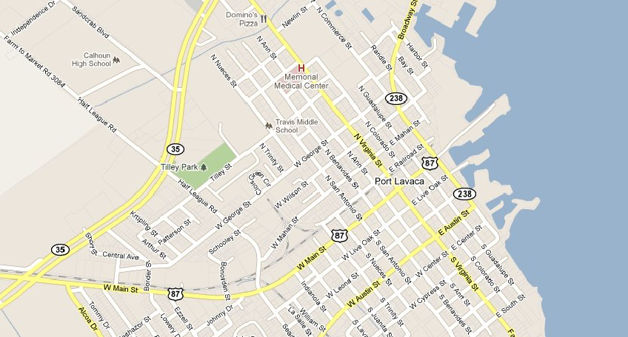
STREET PROJECTS
FY 2017-2018 Down town Sidewalks
$500,000

Slide 6
STREET PROJECTS
FY 2018-2019 Ann & Benavides Street
$400,000

Slide 7
STREET PROJECTS
FY 2019-2020
Jackson Street
$800,000

Slide 8
STREET PROJECTS
FY 2019-2020
George Street
$500,000

Slide 9
Parks Capital Plan
Project | FY 2017-2018 | FY 2018-2019 | FY 2019-2020 | FY 2020-2021 | FY 2021-2022
Description | Budget | Budget | Budget | Budget | Budget
Bay Front Park Improvements
Wilson Park Improvments | $250,000 | $250,000 |  | $250,000 | $250,000
Parks Subtotals | $250,000 | $250,000 | $- | $250,000 | $250,000
General Fund CIP Fund Totals | $900,000 | $800,000 | $1,300,000 | $400,000 | $400,000

Slide 10
WILSON FIELD PARK & RECREATION AREA

Slide 11
Wilson Field Master Plan
ITEM | ITEM DESCRIPTION | UNIT | TOTAL | UNIT | TOTAL
NO. |  |  | QUANTITIES | COST | COST
 | Parking Lots | SF | 13866 | $45.00 | $623,970.00
 | Lighting | EA | 1 | $541,000.00 | $541,000.00
 | Fence | LF | 1696 | $25.00 | $42,400.00
 | Sod | SY | 24720 | $4.00 | $98,880.00
 | Grade/top soil/sod | SY | 20000 | $5.50 | $110,000.00
 | Sidewalk/Trail | SY | 3528 | $40.00 | $141,120.00
 | Basketball Slab | SY | 522 | $30.00 | $15,660.00
 | Skate Park Slab | SY | 600 | $30.00 | $18,000.00
 | Playground | EA | 1 | $90,000.00 | $90,000.00
 | Pavilion/Restroom | EA | 1 | $150,000.00 | $150,000.00
 | Drainage | LS | 1 | $30,000.00 | $30,000.00
 | Cabanas | EA | 5 | $1,000.00 | $5,000.00
 | Swing Set | Ea | 1 | $4,000.00 | $4,000.00
 |  |  |  |  | $1,870,030.00
 | Completed
 |  |  |  | Contingency (15%) | $280,504.50
 |  |  |  | GRAND TOTAL | $2,150,534.50
 |  |  |  | Completed | $912,280.00
 |  |  |  | Remaining | $1,238,254.50

Slide 12
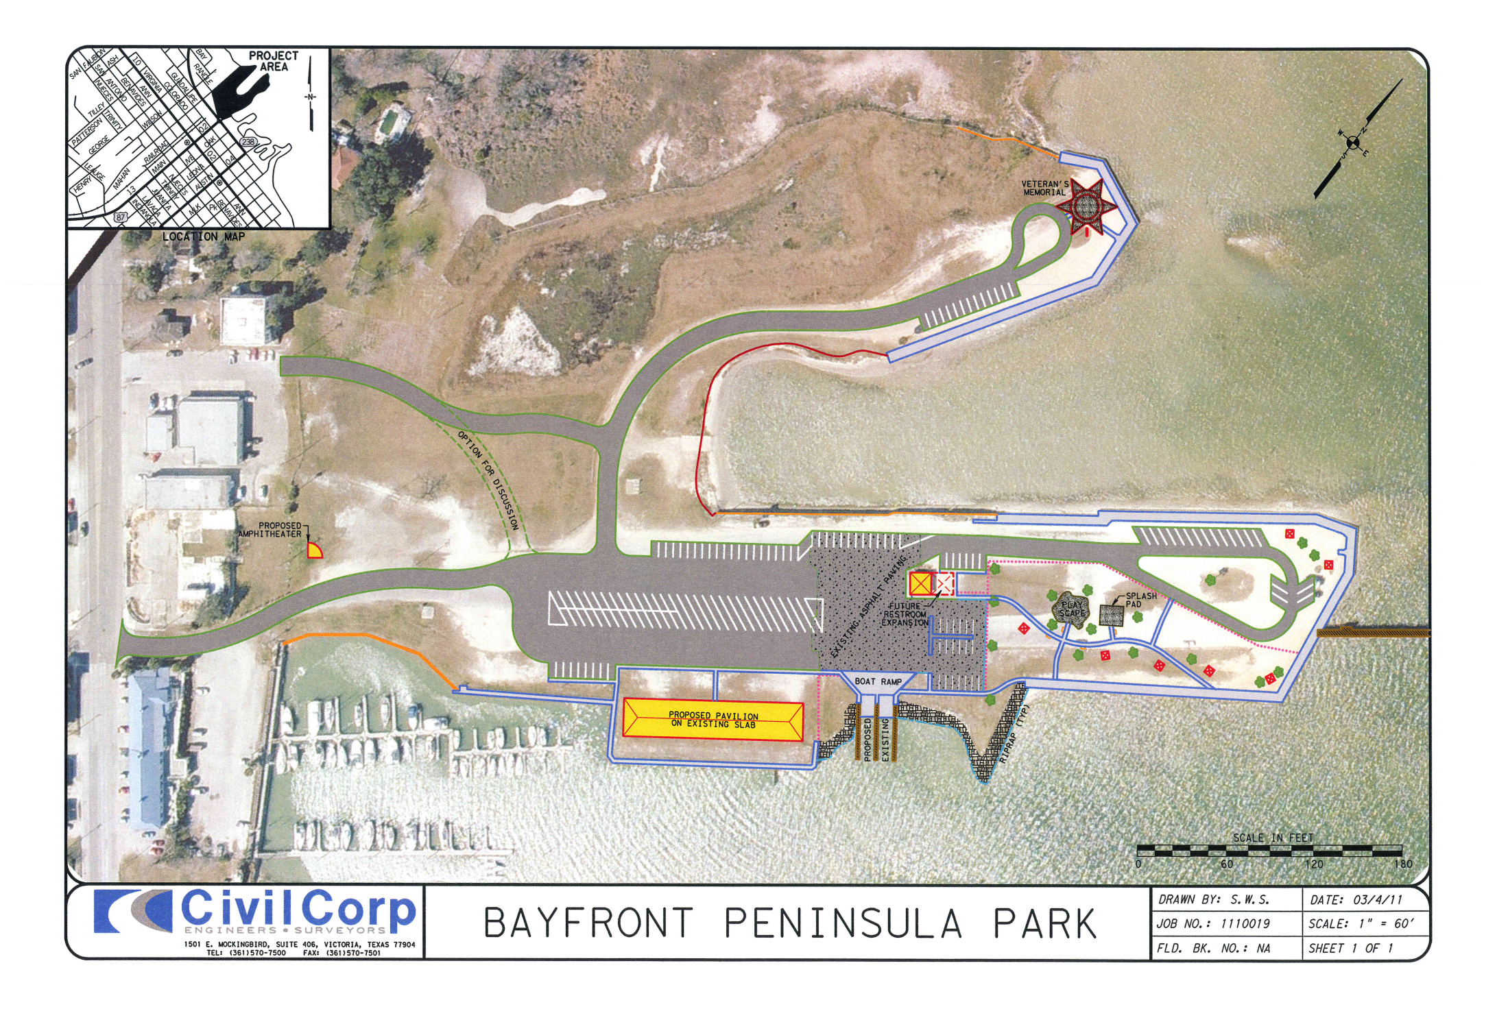

Slide 13
Bayfront Peninsula Park Master Plan
ITEM | ITEM DESCRIPTION | UNIT | TOTAL | UNIT | TOTAL
NO. |  |  | QUANTITIES | COST | COST
 | Parking Lots | SF | 8248 | $45.00 | $371,160.00
 | Sidewalk | SY | 813 | $40.00 | $32,520.00
 | New Pavillion | EA | 1 | $200,000.00 | $200,000.00
 | Restroom | EA | 1 | $103,000.00 | $103,000.00
 | Boatramp | EA | 1 | $500,000.00 | $500,000.00
 | Playground | EA | 1 | $100,000.00 | $100,000.00
 | Amphi Theaqter | LS | 1 | $100,000.00 | $100,000.00
 | Seal Coat | SY | 5950 | $3.50 | $20,825.00
 | New Street | SY | 2000 | $45.00 | $90,000.00
 | Underground Power
 | & Lighting | LS | 1 | $65,000.00 | $65,000.00
 |  |  |  |  | $1,582,505.00
 | Complete
 |  |  |  | Contingency (15%) | $237,375.75
 |  |  |  | GRAND TOTAL | $1,819,880.75
 |  |  |  | Completed | $968,000.00
 |  |  |  | Remaining | $851,880.75

Slide 14
Utility Fund
Project | FY 2017-2018 | FY 2018-2019 | FY 2019-2020 | FY 2020-2021 | FY 2021-2022
Description | Budget | Budget | Budget | Budget | Budget
Water System
Virginia from Main to South | $700,000
Colorado St. from Main to Live Oak | $60,000
Jackson St. Water Line |  | $165,000
Indianola from Austin to Main/Leona |  | $200,000
Brookhollow Drive Water Line |  |  | $300,000
Broadway Water Line |  |  | $165,000
Live Oak from Commerce to Virginia |  |  |  | $300,000
Leon St. Water Line |  |  |  |  | $400,000
Water System Subtotals | $760,000 | $365,000 | $465,000 | $300,000 | $400,000
Wastewater System
UV System WWTP | $350,000
Center Street Sewer Line Phase I | $300,000
Geo. St. from H. League to Arthur/Knipling |  | $200,000
De Shazor Sewer Line Phase I |  |  | $300,000
De Shazor Sewer Line Phase Il |  |  |  | $300,000
Upgrade Ann Lift Station |  |  |  |  | $250,000
Wastewater Subtotals | $650,000 | $200,000 | $300,000 | $300,000 | $250,000
Utility System CIP Fund Totals: | $1,410,000 | $565,000 | $765,000 | $600,000 | $650,000

Slide 15
Utility Fund- Funding Sources
FY 2017-2018 | FY 2018-2019 | FY 2019-2020 | FY 2020-2021 | FY 2021-2022
Budget | Budget | Budget | Budget | Budget
Utility System CIP Fund Totals: | $1,410,000 | $565,000 | $765,000 | $600,000 | $650,000
Funding Source:
Operating Budget |  | $- | $- | $- | $-
Grant | $250,000
Depreciation Reserves | $1,160,000 | $565,000 | $765,000 | $600,000 | $600,000
Total Resources Planned | $1,410,000 | $565,000 | $765,000 | $600,000 | $600,000

Slide 16
Water Capital Plan
Project | FY 2017-2018 | FY 2018-2019 | FY 2019-2020 | FY 2020-2021 | FY 2021-2022
Description | Budget | Budget | Budget | Budget | Budget
Virginia from Main to South | $700,000
Colorado St. from Main to Live Oak | $60,000
Jackson St. Water Line |  | $165,000
Indianola from Austin to Main/Leona |  | $200,000
Brookhollow Drive Water Line |  |  | $300,000
Broadway Water Line |  |  | $165,000
Live Oak from Commerce to Virginia |  |  |  | $300,000
Leon St. Water Line |  |  |  |  | $400,000
Water System Subtotals | $760,000 | $365,000 | $465,000 | $300,000 | $400,000

Slide 17
WATER PROJECTS
FY 2017-2018
Virginia Street Waterline
$700,000

Slide 18
WATER PROJECTS
FY 2017-2018
Colorado St Waterline
Main to Live Oak
$60,000

Slide 19
WASTEWATER PROJECTS
FY 2018-2019
Jackson Street
Waterline
$165,000

Slide 20
WATER PROJECTS
FY 2018-2019
Indianola /Leona Waterline
$200,000

Slide 21
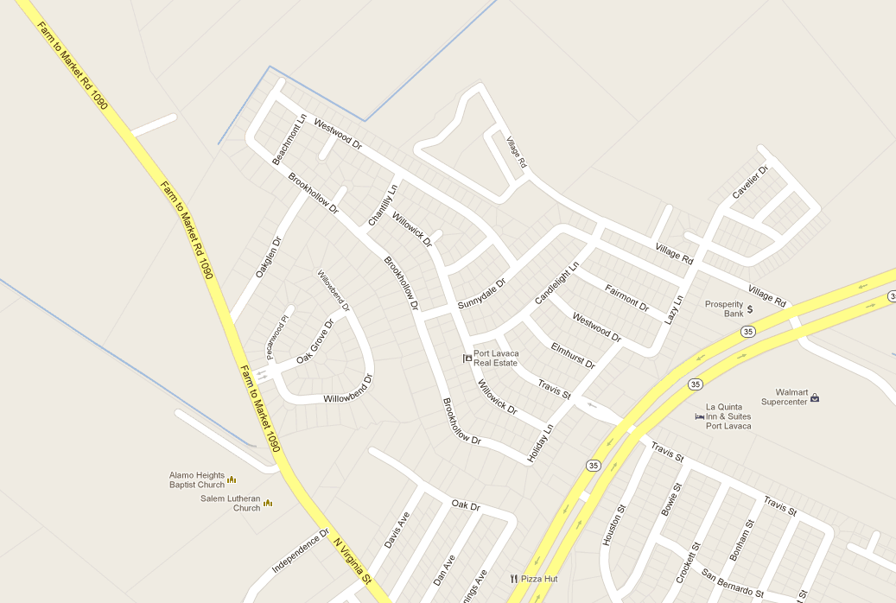
WATER PROJECTS
FY 2019-2020
Brookhollow DR
$ 300,000

Slide 22
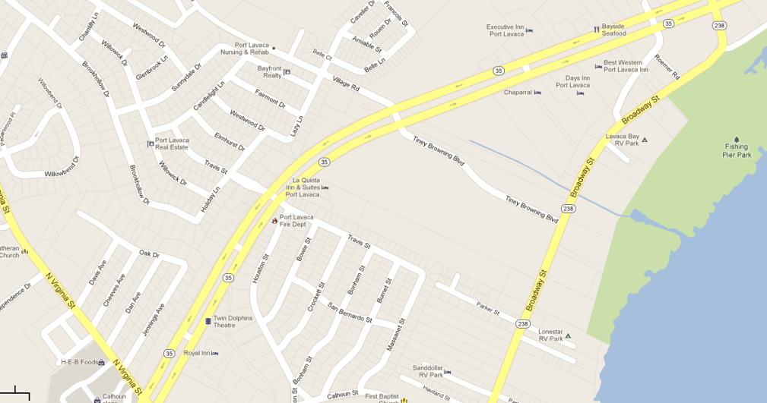
WATER PROJECTS
FY 2019-2020
Broadway Water
$165,000

Slide 23
WATER PROJECTS
FY 2020-2021
Live Oak-Commerce to Virginia
$300,000

Slide 24
WASTEWATER PROJECTS
FY 2021-2022
Leon Street
Waterline
$400,000

Slide 25
Wastewater Capital Plan
Project | FY 2017-2018 | FY 2018-2019 | FY 2019-2020 | FY 2020-2021 | FY 2021-2022
Description | Budget | Budget | Budget | Budget | Budget
UV System WWTP | $350,000
Center Street Sewer Line Phase I | $300,000
Geo. St. from H. League to Arthur/Knipling |  | $200,000
De Shazor Sewer Line Phase I |  |  | $300,000
De Shazor Sewer Line Phase Il |  |  |  | $300,000
Upgrade Ann Lift Station |  |  |  |  | $250,000
Wastewater Subtotals | $650,000 | $200,000 | $300,000 | $300,000 | $250,000

Slide 26
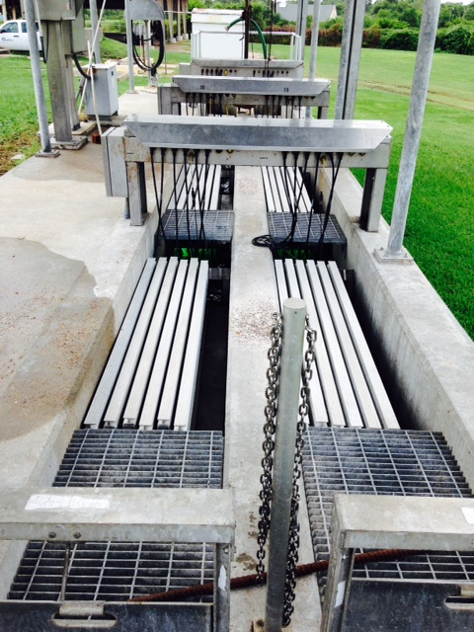
WASTEWATER PROJECTS

Slide 27
WASTEWATER PROJECTS
FY 2017-2018
Center Street Phase I Sewer
$300,000

Slide 28
WASTEWATER PROJECTS
FY 2018-2019
George St. $200,000

Slide 29
WASTEWATER PROJECTS
FY 2019-2020
De Shazor Area Phase 1 Sewer
$300,000
FY 2019-2020
De Shazor Area Phase 1 Sewer
$300,000

Slide 30
WASTEWATER PROJECTS
FY 2020-2021
De Shazor Area Phase 2 Sewer
$300,000

Slide 31
FY 2021-2022
Upgrade Ann Lift Station
$250,000

Slide 32
Lighthouse Beach
Project | FY 2017-2018 | FY 2018-2019 | FY 2019-2020 | FY 2020-2021 | FY 2021-2022
Description | Budget | Budget | Budget | Budget | Budget
Upgrade Trailer Spaces | $50,000 |  | $50,000
Demolition of Abandoned Pier (Grant) | $250,000
Upgrade Boat Ramp |  | $60,000
Cabanas with tables including camping area |  |  |  | $50,000
Playground by Camping Area |  |  |  |  | $50,000
Subtotals: | $300,000 | $60,000 | $50,000 | $50,000 | $50,000
Light House Beach CIP Fund Totals | $300,000 | $60,000 | $50,000 | $50,000 | $50,000
Funding Source:
Operating Budget | $34,000 | $36,000 | $38,000 | $30,000 | $38,000
Grant | $200,000
Operational Savings (Reserve) | $66,000 | $24,000 | $12,000 | $20,000 | $12,000
Total Resources Planned | $300,000 | $60,000 | $50,000 | $50,000 | $50,000

Slide 33
Port Commission
Project | FY 2017-2018 | FY 2018-2019 | FY 2019-2020 | FY 2020-2021 | FY 2021-2022
Description | Budget | Budget | Budget | Budget | Budget
Bulkhead-Harbor of Refuge |  |  | $2,000,000
Bulkhead-Bayfront Park |  |  | $250,000
Bulkhead-City Harbor Tract 1
City Harbor Upper and Lower Dock
Breakwater-Scully's
Breakwater-Nautical Landings Marina
Restore Fund |  |  | $500,000
Subtotals: | $- | $- | $2,250,000 | $- | $-
Port Commission CIP Fund Totals: | $- | $- | $2,250,000 | $- | $-

Slide 34
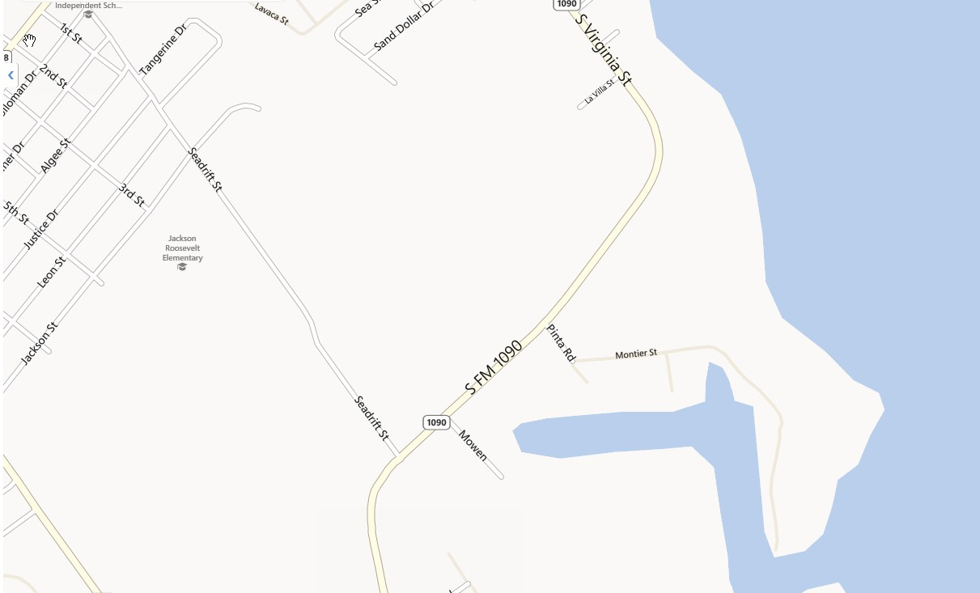
PORT COMMISSION PROJECTS
FY 2019-2020
Bulkhead-
Harbor of Refuge
Port Commission
$2,000,000

Slide 35
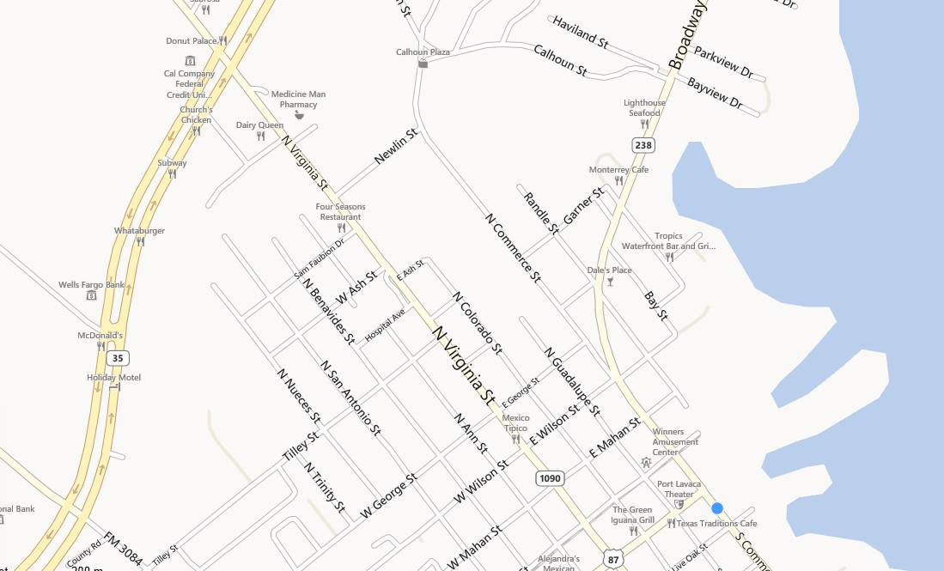
PORT COMMISSION PROJECTS
FY 2019-2020
Bayfront Peninsula Bulkhead & Sidewalk
$250,000

Slide 36
PORT COMMISSION PROJECTS
FY 2019-2020
Breakwater-Nautical Landings Marina
$

Slide 37
PORT COMMISSION PROJECTS
FY 2019-2020
Bulkhead City Harbor Tract 1
$

Slide 38
PORT COMMISSION PROJECTS
FY 2019-2020
City Harbor-Upper and lower Dock
$

Slide 39
PORT COMMISSION PROJECTS
FY 2019-2020
Breakwater-Scully’s
$

